Slide 1
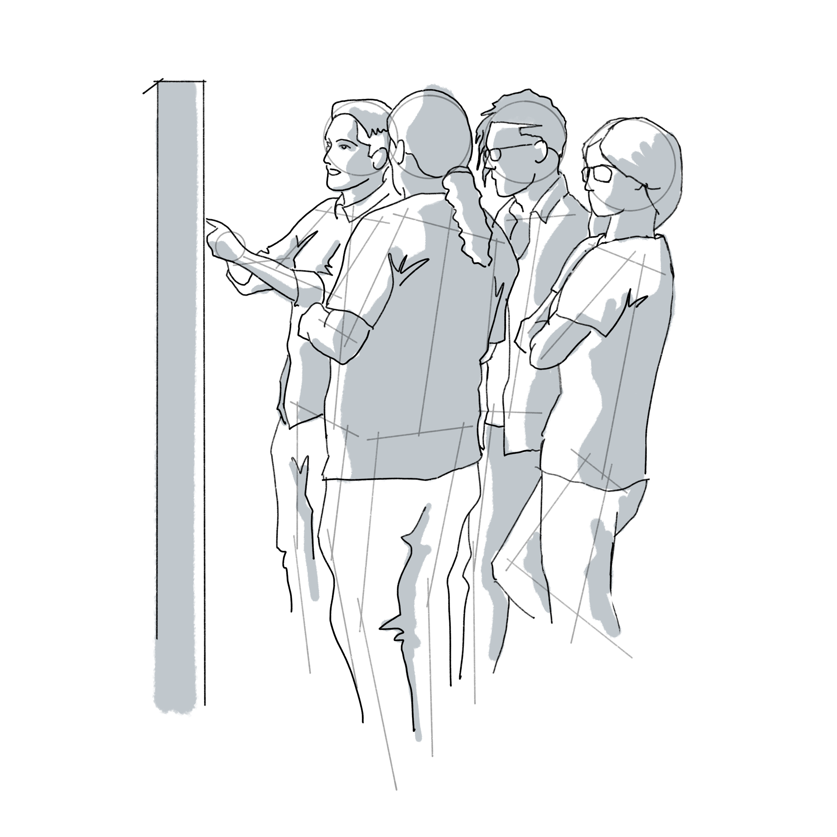
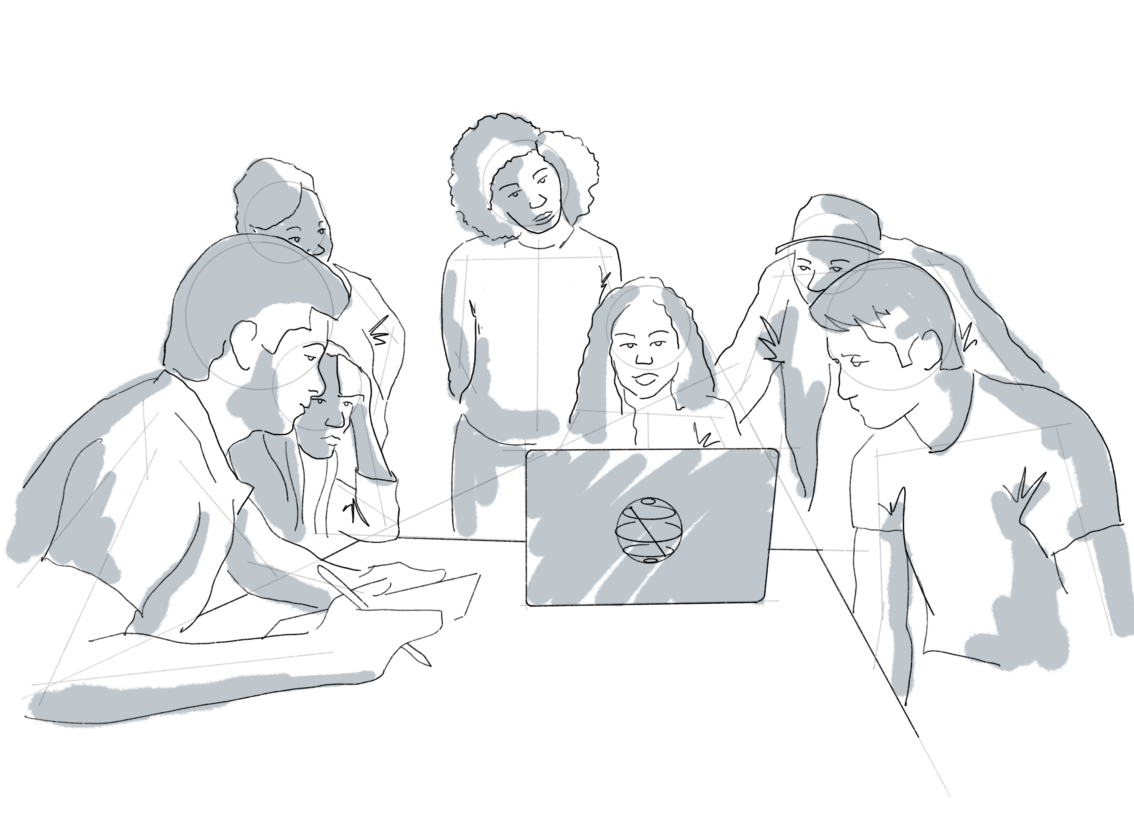
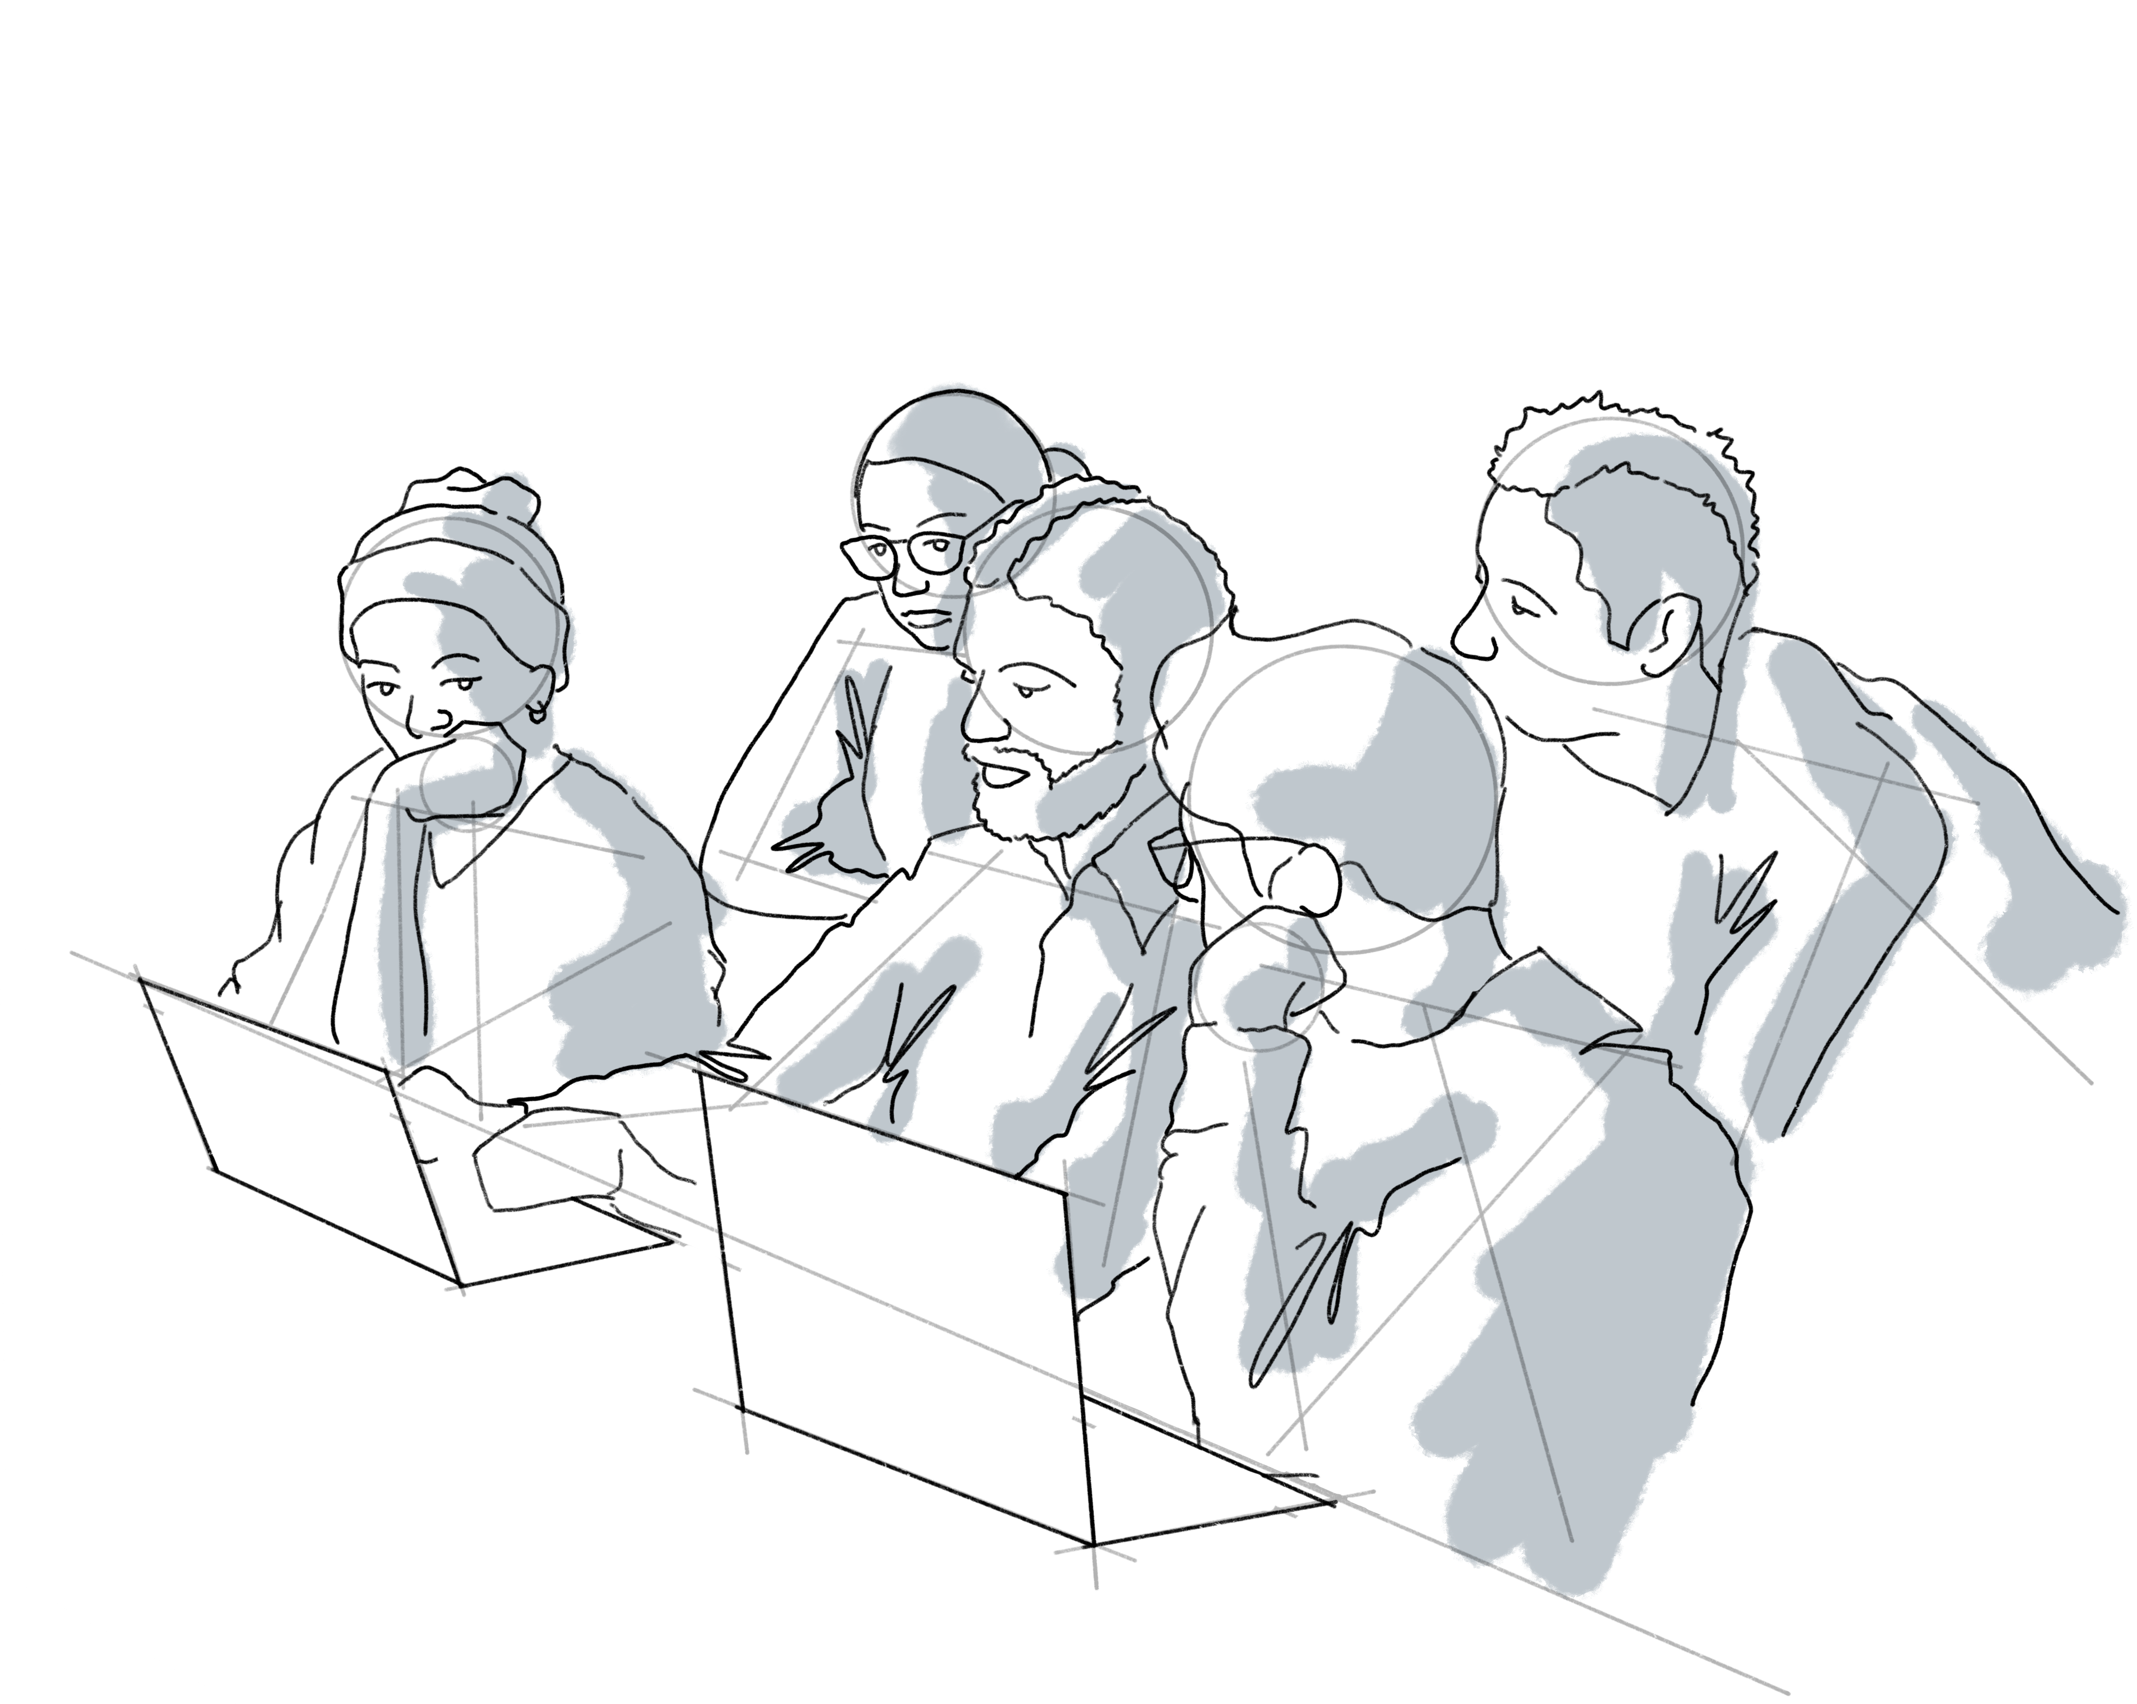
IBM Quantum Spring Challenge 2023: A walkthrough!
Vishal Sharathchandra Bajpe
Quantum Developer Community Advocate, IBM Quantum

Slide 2
Agenda for today
Breadth not depth – IBM Quantum Spring Challenge
High level inspiration and walkthrough the IBM Quantum Spring Challenge 2023 – Themed around Dynamic circuits.
Brief introduction about IBM Quantum Challenges and why should one join them
Brief setup and theme introduction of the Spring Challenge 2023 labs
Brief walkthrough of labs and what were the problem statements posed in the labs and how you can try them.

Slide 3
What are IBM Quantum Challenges?

Slide 4
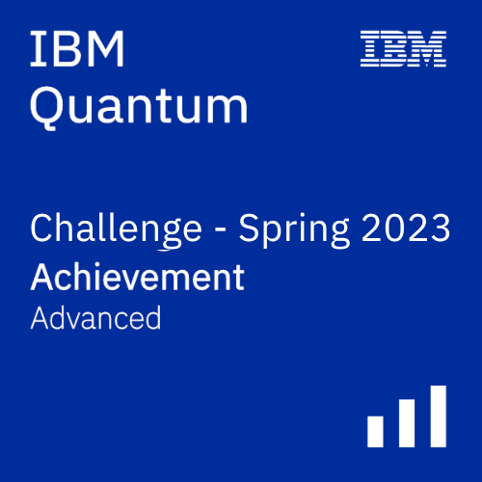
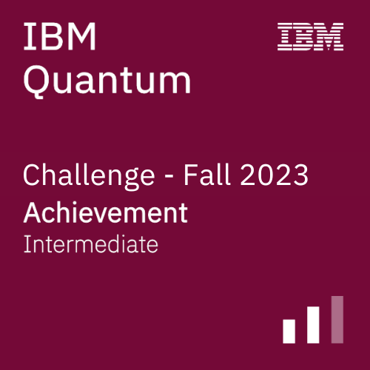
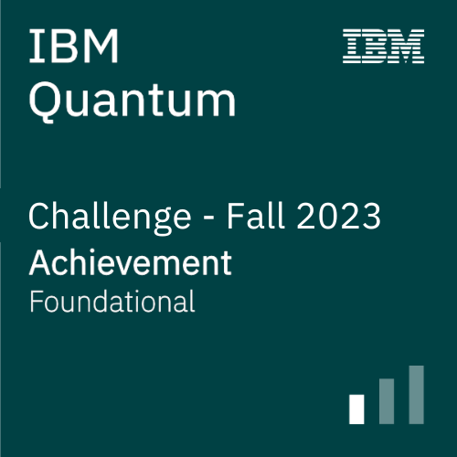
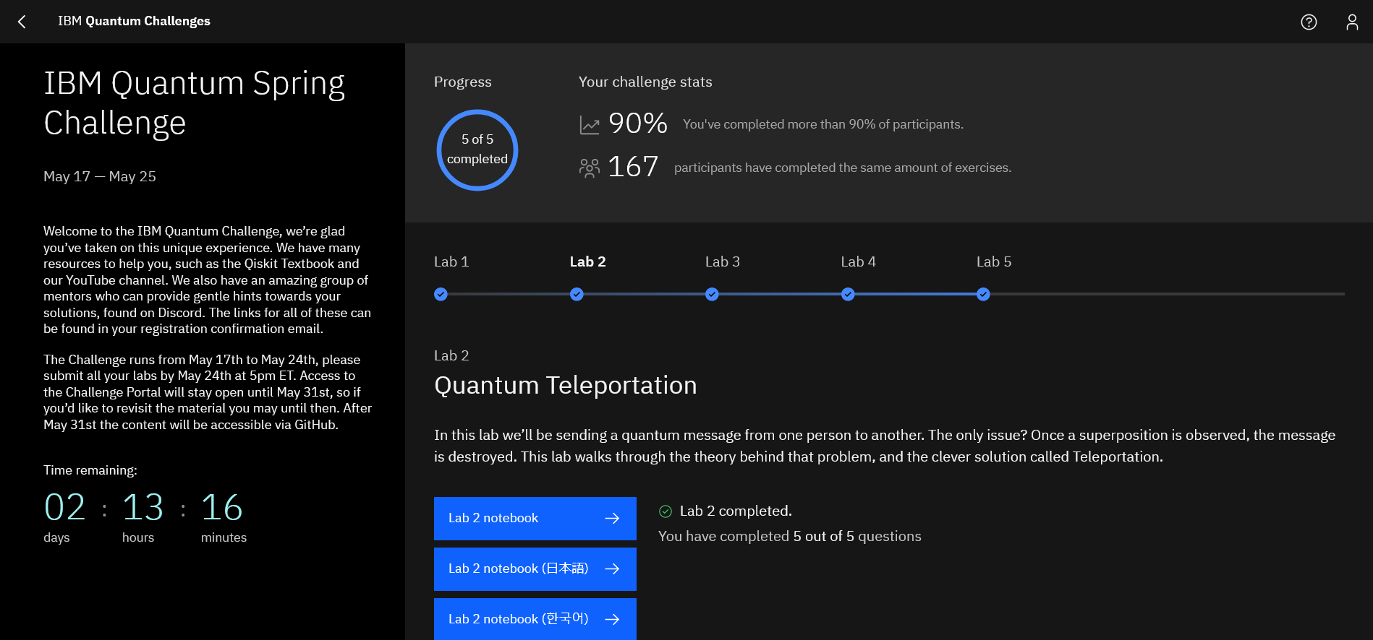
- A series of time-bound labs open for participants to solve. - Mixture of tutorial content and challenging exercises with autograding.
What are IBM Quantum Challenges?

Slide 5

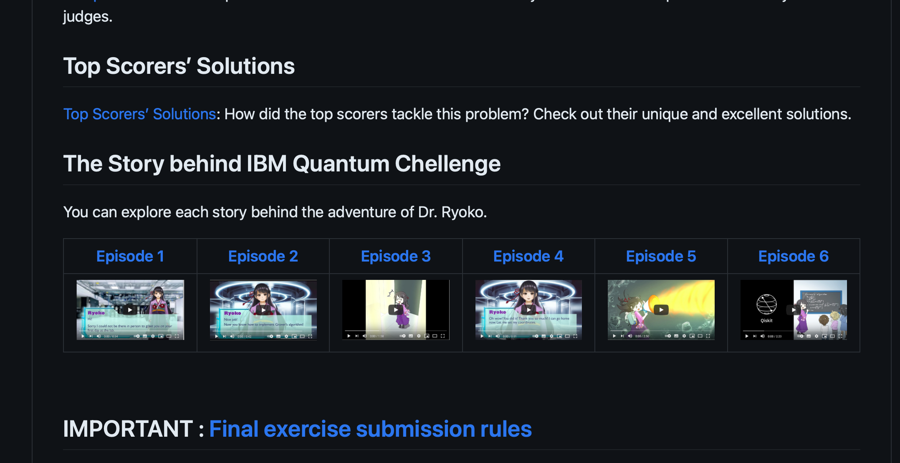

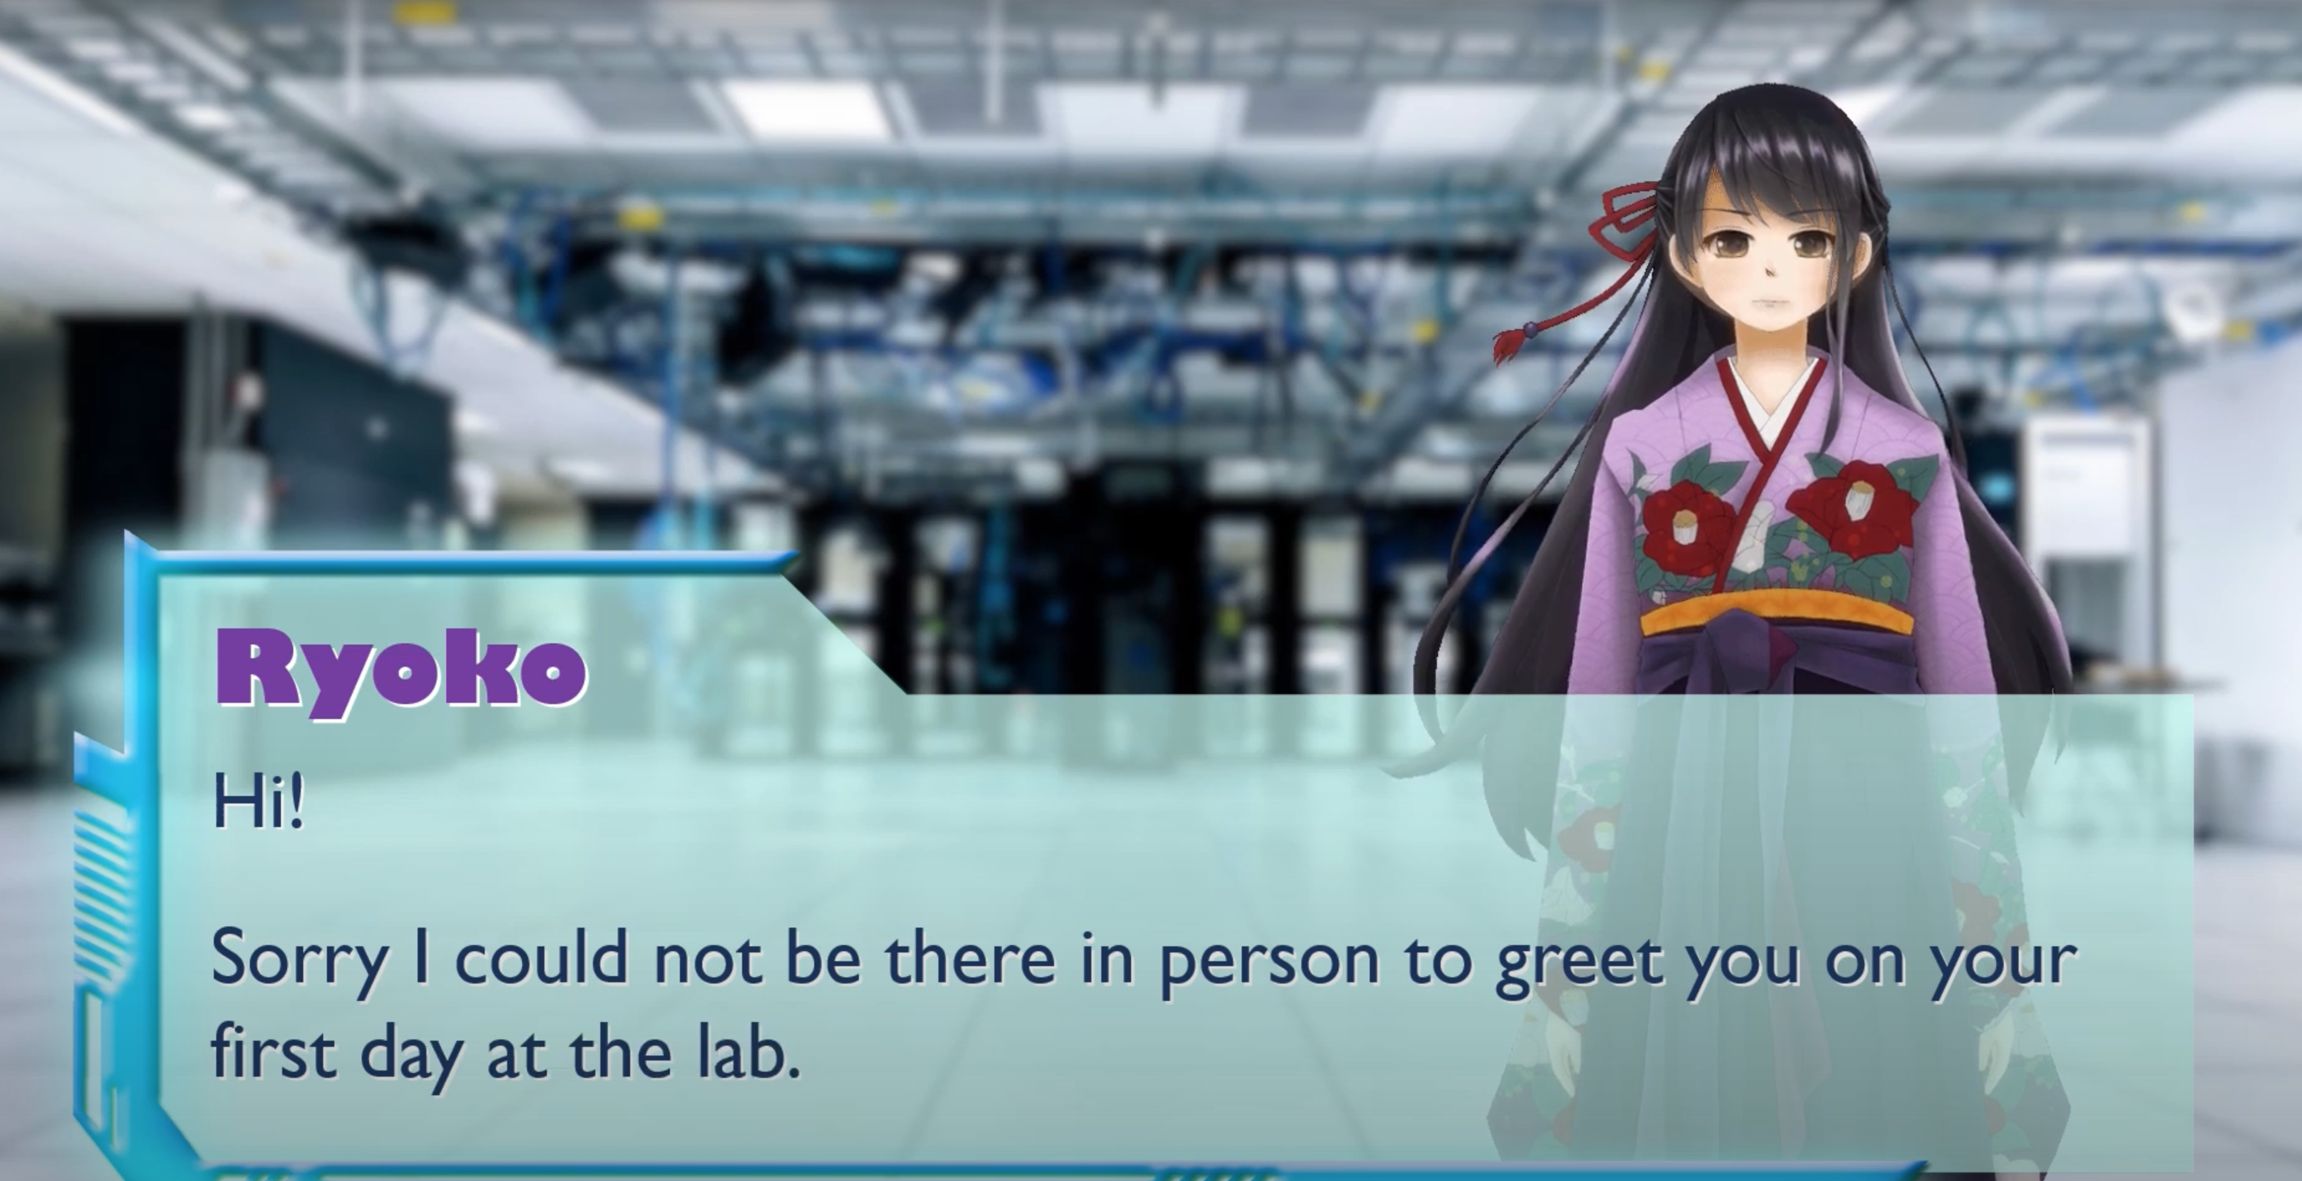
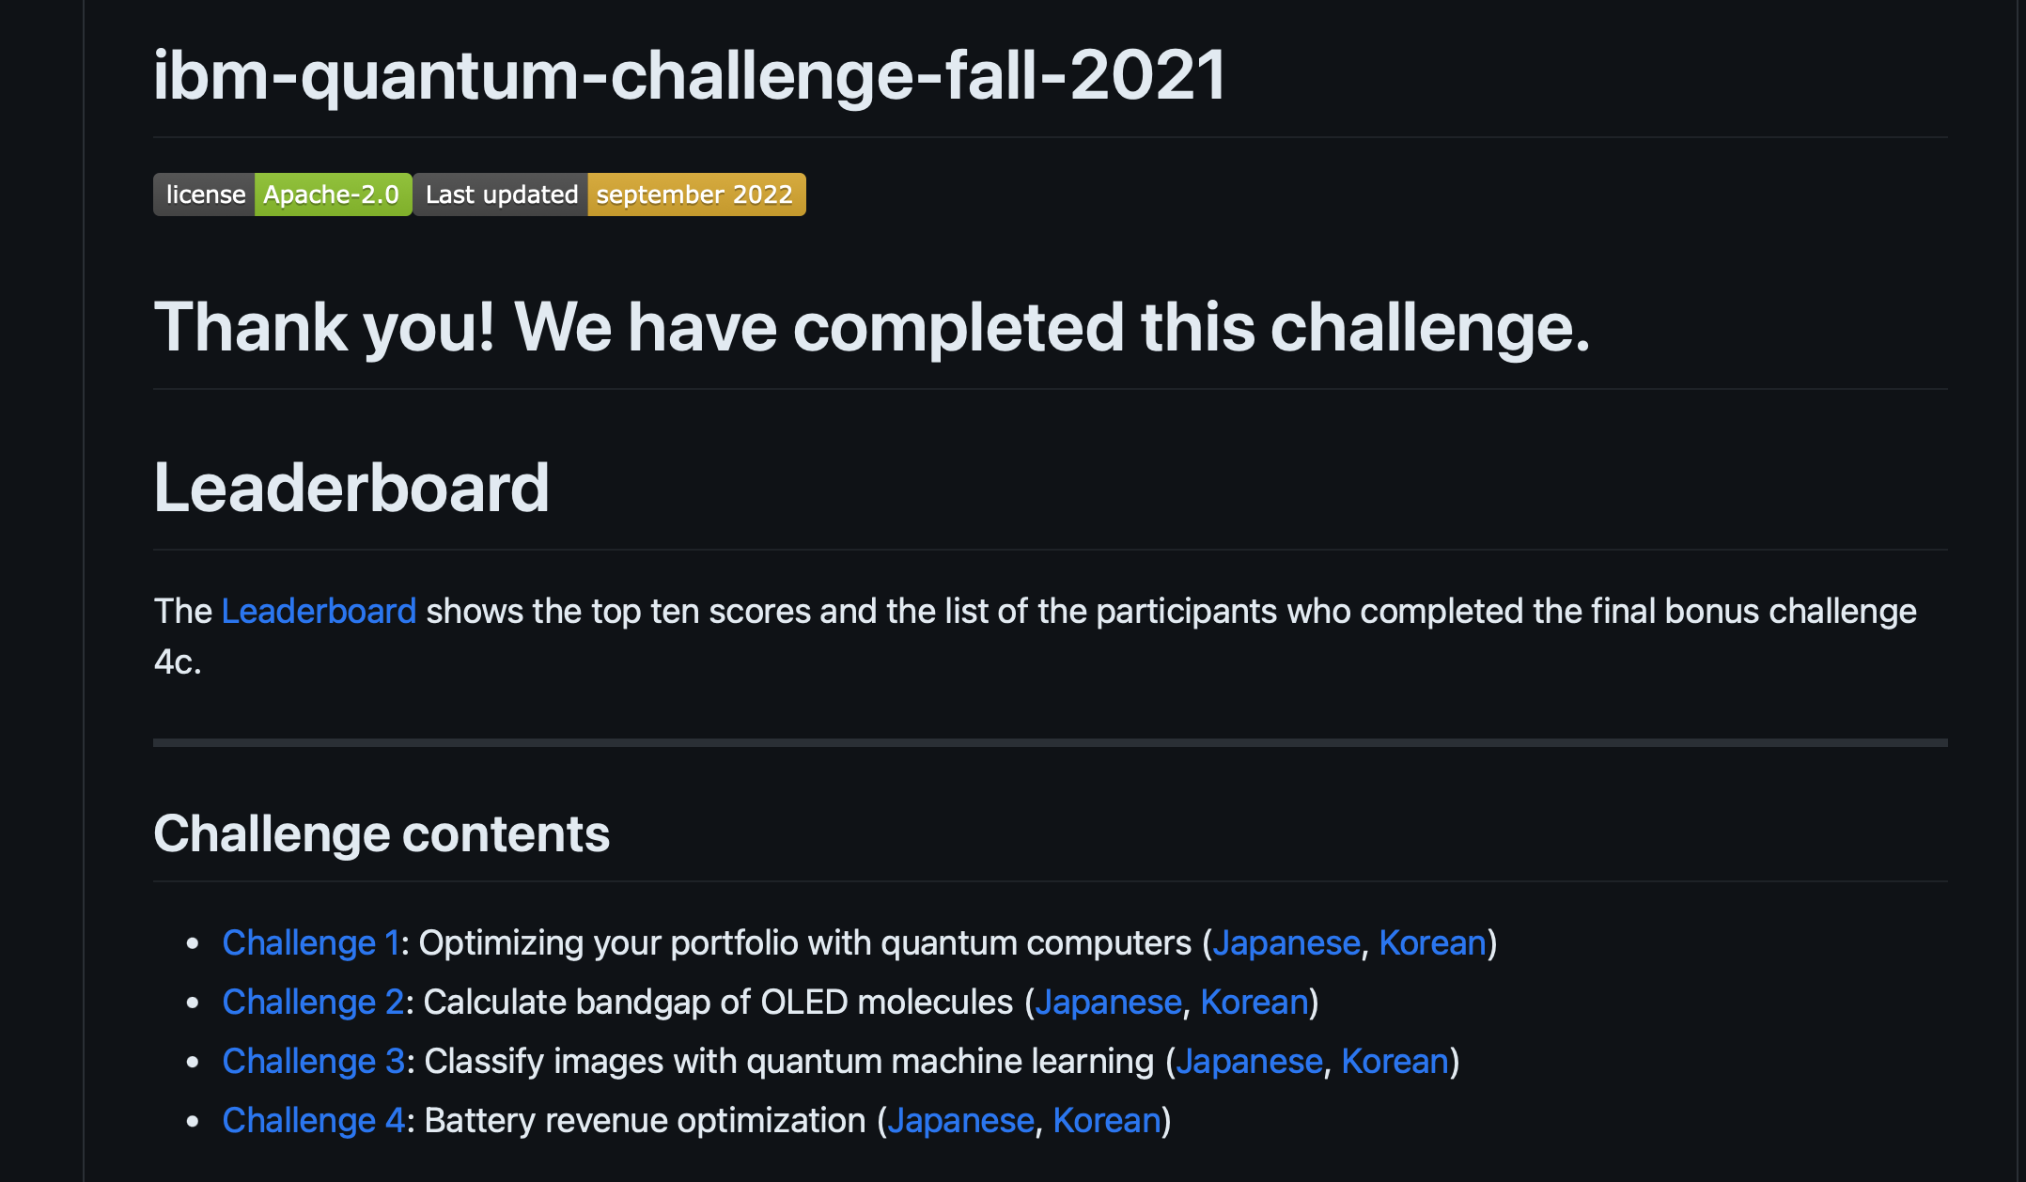
Running and open for all since 2019!

Slide 6
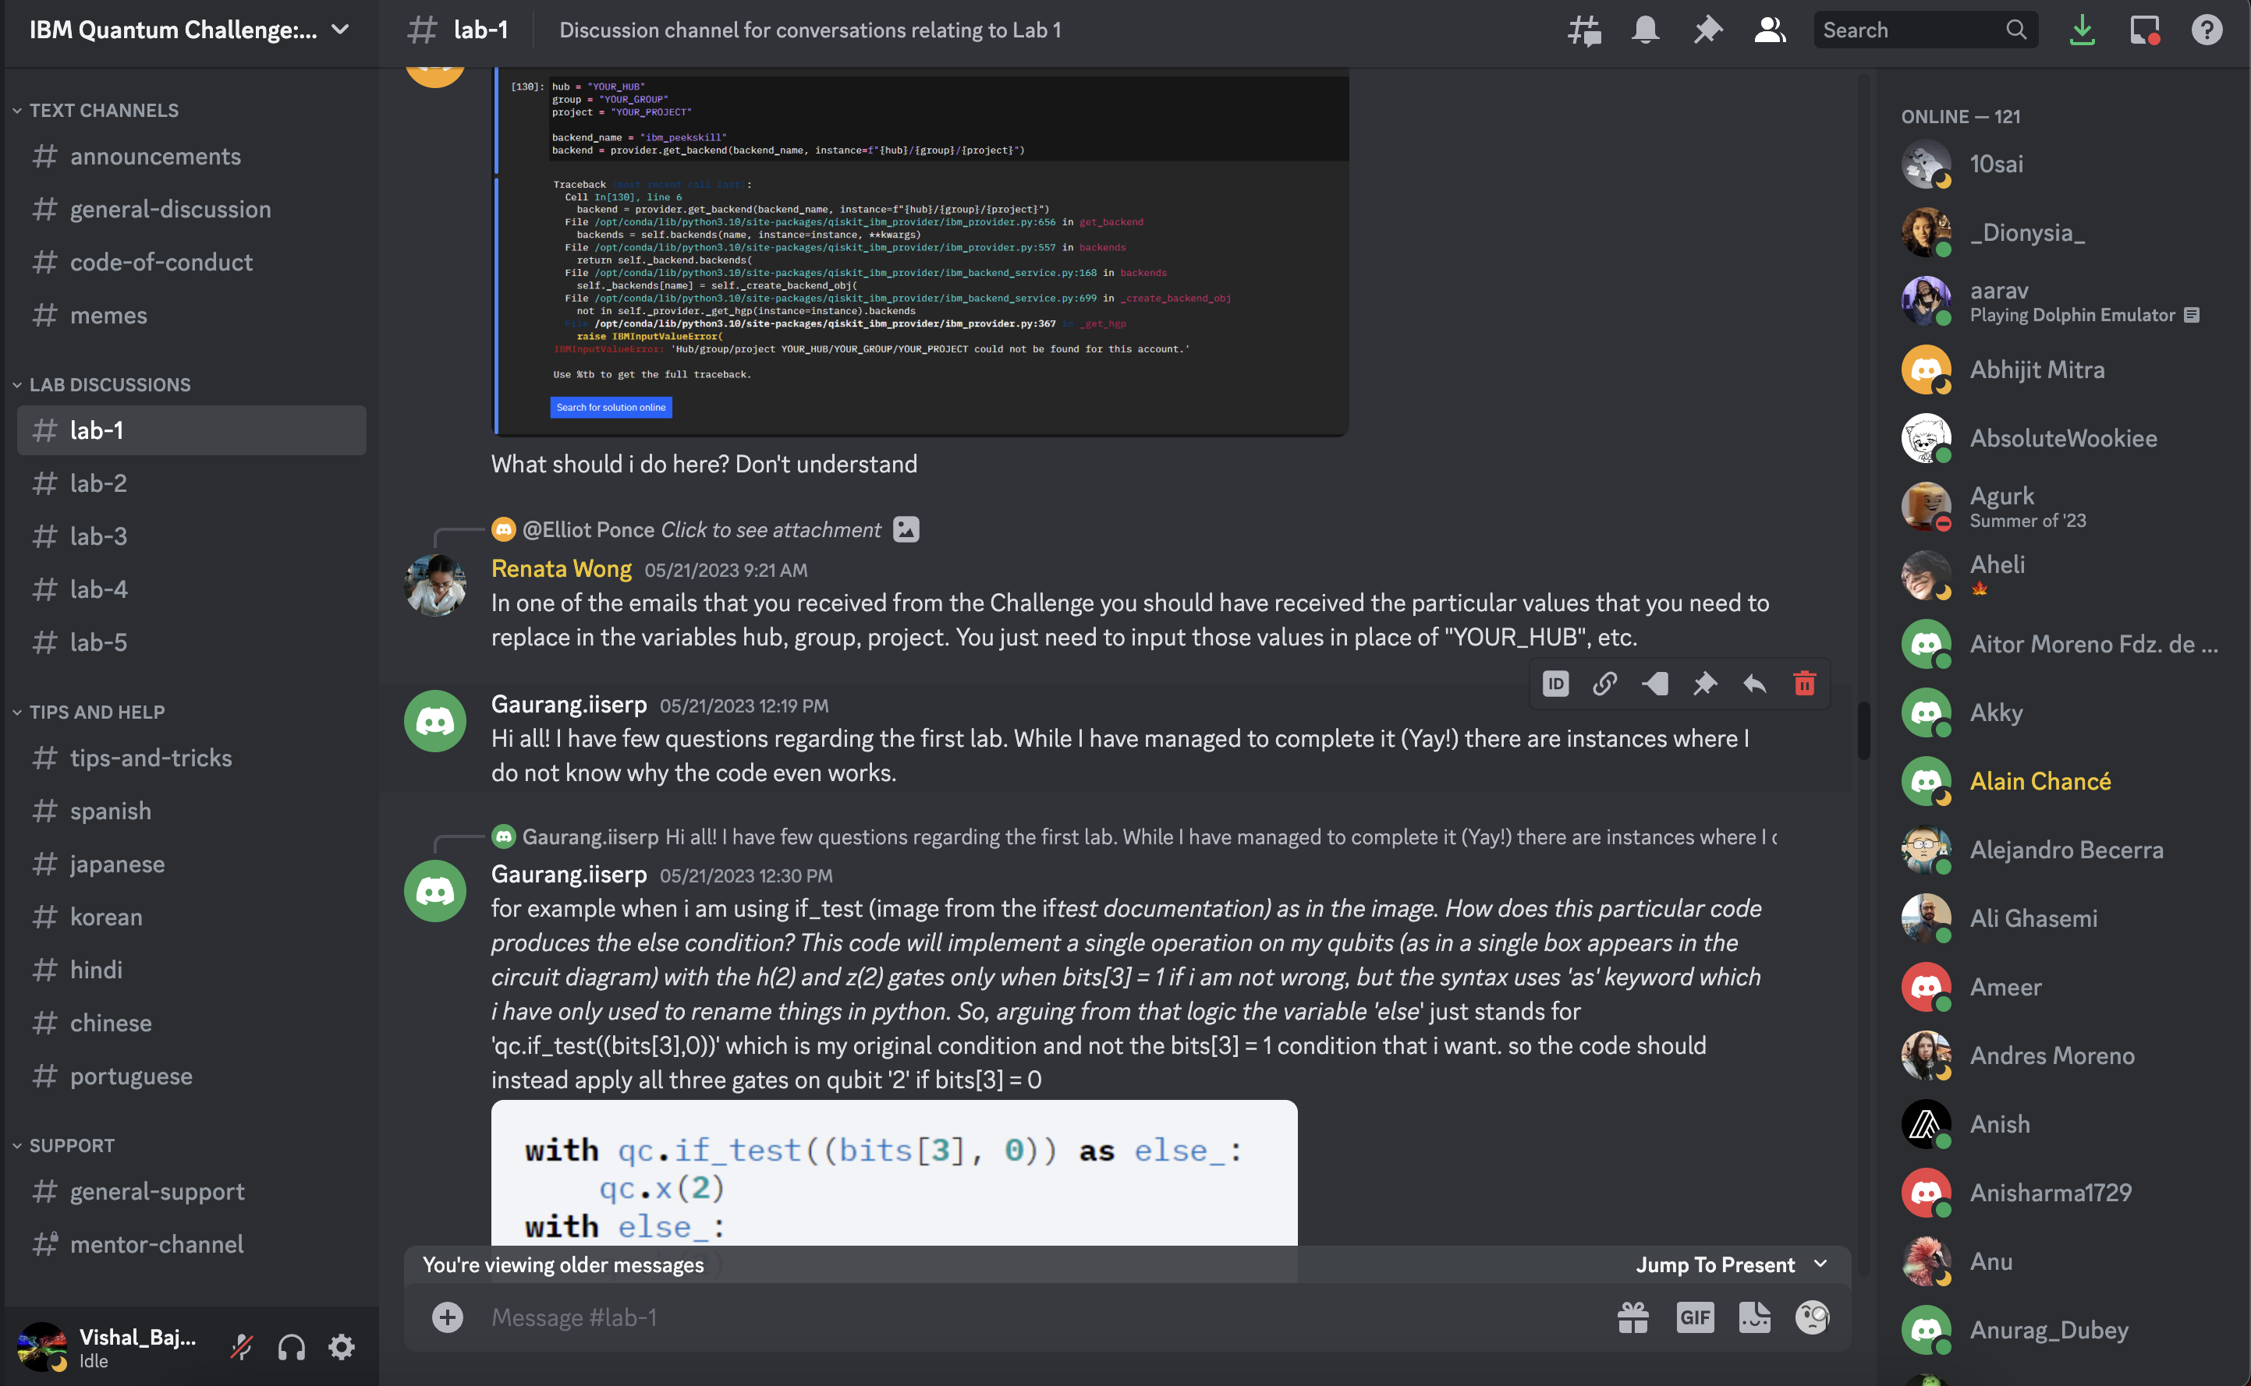
Communication and peer support
Discord/ Slack server and community for networking

Slide 7

Credly Badges!

Slide 8
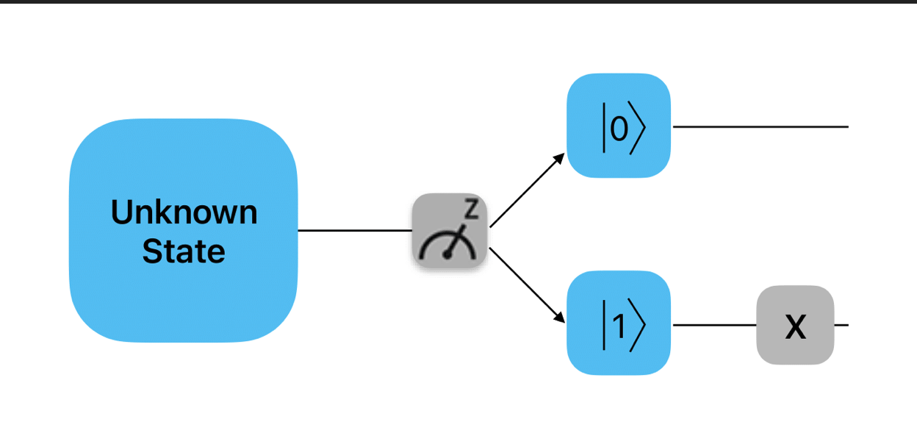
Theme: Dynamic Circuits
"A quantum circuit is a computational routine consisting of coherent quantum operations on qubits ... It is an ordered sequence of quantum gates, measurements and resets, all of which may be conditioned on and use data from the real-time classical computation."
Dynamic circuits are quantum circuits that contain mid-circuit measurements where the results of those measurements are used to condition quantum gates later in the circuit.
The ability to condition future quantum operations on the classical measurement results is known as classical feedforward.

Slide 9
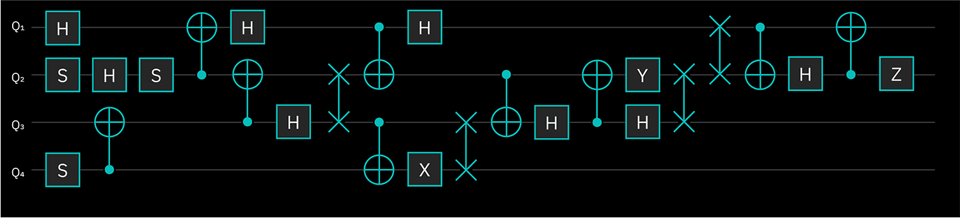
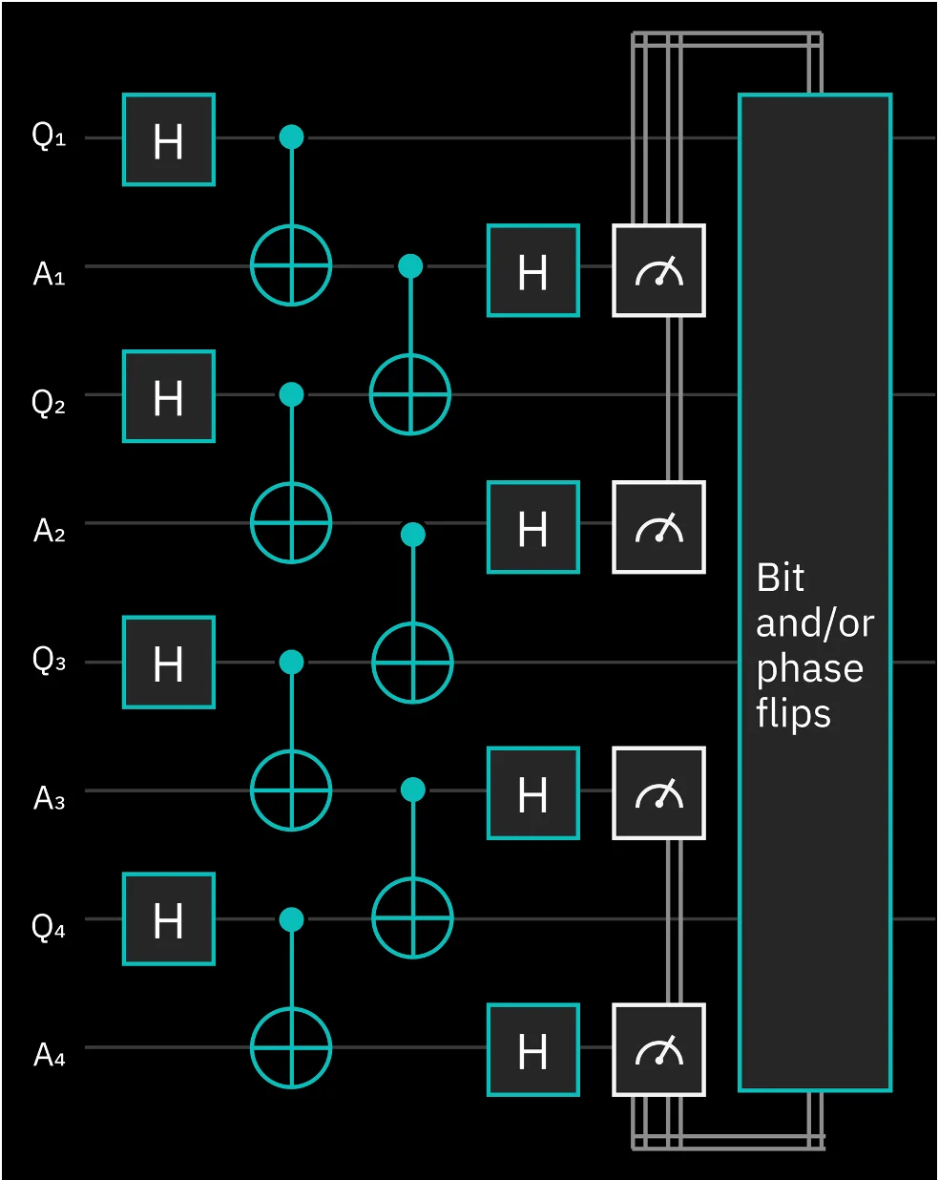
Theme: Dynamic Circuits
Example: Before – Static Quantum Circuit
Example: After – Dynamic Quantum Circuit

Slide 10
Need for feedforward?
Useful for faster and less error prone resets: A reset operation is a non-unitary operation that resets the qubit to the zero state no matter the initial state
The conditional reset operation is performed on an already measured qubit to reset it to zero by applying a bit-flip X gate only if the qubit is in the one state, as determined from its measured value.
Also introduces concepts like control flow and opens up to routines like if statements, switch case, for loop, while loop
if-else
for loop
switch case
while loop

Slide 11
Showcase Dynamic circuits through labs
Lab 1: Introductory exercise
Lab 2: Quantum Teleportation
Lab 3: Iterative Phase Estimation
Lab 4: Quantum Error Correction (Bit Flip)

Slide 12
Showcase Dynamic circuits through labs
Lab 1: Introductory exercise
Lab 2: Quantum Teleportation
Lab 3: Iterative Phase Estimation
Lab 4: Quantum Error Correction (Bit Flip)
Bonus Lab 5: Ghz on 127 qubits

Slide 13
Brief Walkthrough

Slide 14
Thank you for your time.

